Slide 1
Cognitive Processes - II
CS-411
Week 5

Slide 2
In the Last Lecture
Attention
Memory

Slide 3
In Today’s Lecture
Learning
Reading, Speaking, Listening
Thinking
Skill Acquisition

Slide 4
Learning
Involves
Understanding concepts and rules
Memorization
Acquiring motor skills

Slide 5
Learning
Learning can be
Procedural
Learning Motor Skills
How to use a computer based application
Declarative
Gaining Knowledge through association of concepts.
Using a computer based application to understand a topic

Slide 6
Learning Preference
People Prefer Learning through Doing.
People usually do not prefer reading or following instructions.

Slide 7
Difficulty of Learning
Concrete experience of physical world
High level abstraction
Easy to relate

Slide 8
Difficulty of Learning - Solution
Learning can be made easy through: (Doing)
GUI and direct manipulation interface
Training wheels approach
restrict to basic functions (Novice users)
Use interactive technologies
Web
Multimedia
Virtual Reality
Augmented Reality

Slide 9
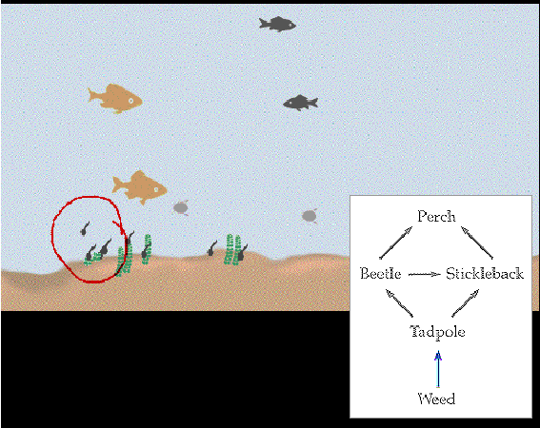
Dynalinking
Abstract representation are linked with more concrete interactive
illustration.
Pondworld

Slide 10
Consequences
Design interfaces that encourage exploration.
Design interfaces that constrain and guide users to select appropriate actions.
Dynamically link concrete representations and abstract concepts to facilitate complex learning.

Slide 11
Reading, Speaking, Listening
3 forms of language processing
Reading, Speaking, Listening
Have similar properties
Have similar meaning of words
Example:
Read, Speak or Listen to following sentence
“Computers are wonderful operations”
They all have meaning

Slide 12
Reading, Speaking, Listening
Ease of modes differ depending on
Person
Task
Context

Slide 13
Comparison of Language Modes
Written Language ……………………….Permanent
Listening ……………………………………..Transient
Reading ………………………………………Quicker
Speaking/Listening ……………………Slower
Listening …………………………………Easier
Reading/Speaking …………………..Harder

Slide 14
Comparison of Language Modes
Written Language ………………….grammatical/Formal
Spoken Language ……..often less Grammatical/Formal
Personal preference
Disabilities affect language processing

Slide 15
Using Language Processing in Applications
Interactive Books/Web sites
Speech-recognition systems
Speech-output systems
Natural-language systems
Interface for people with language processing disabilities

Slide 16
Consequences
Keep the length of speech-based menus and instructions to a minimum.
Accentuate the intonation of artificially generated speech voices, as they are harder to understand than human voices.
Provide opportunities for making text large on a screen, without affecting the formatting, for people who find it hard to read small text.

Slide 17
Thinking
Which cognition mode?
Involve conscious process
Aware of oneself
Making decision
Looking at different options
Can be categorized as
Reasoning
Problem Solving

Slide 18
Reasoning
Process by which we use the knowledge we possess to draw conclusions or infer something new about the domain of interest.
Types of reasoning
Deductive reasoning
Inductive reasoning
Abductive reasoning

Slide 19
Deductive Reasoning
Deductive reasoning derives the logically necessary conclusion from the given premises.
Example:
If it is Friday then she will go to work
It is Friday
Therefore she will go to work
Can be misapplied.
Some people are babies
Some babies cry
???

Slide 20
Inductive Reasoning
Induction is generalizing from cases we have seen to infer information about cases we have not seen.
Example:
If every elephant we have ever seen has a trunk, we infer that all elephants have trunks

Slide 21
Abductive Reasoning
Abduction reasons from a fact to the action or state that caused it.
Example:
He drives fast
He had an accident
Fast driving causes accident

Slide 22
Problem Solving
Problem solving is the process of finding a solution to an unfamiliar task, using the knowledge we have.
3 theories of problem solving
Gestalt
Problem Space theory
Analogy in problem solving

Slide 23
Gestalt Theory
Gestalt theory
Problem solving is
Productive
Reproductive
Productive Problem Solving
Involves
Insight
Restructuring of problem

Slide 24
Problem State Theory
Problem States
has
Problem Space
Legal State Transition
Operators
Problem

Slide 25
Problem State Theory
Problem
Initial State
Goal State
Operators
(used by People)
Select Operators
Heuristics (e.g. mean-ends analysis)

Slide 26
Means-Ends Analysis
Example: Move desk from north wall to window
Desk
North Wall
Window

Slide 27
Means – Ends Analysis
Initial State: Desk at North wall
Goal State: Desk at window
Difference: Location of Desk
Available Operators
Push desk
Drag desk
Carry desk

Slide 28
Means-Ends Analysis
Decided to
carry desk
To carry must be light
Desk is heavy
Make desk light (sub-goal)
Make desk light (sub-goal)
Remove drawers

Slide 29
Example
Identify the goals and operators involved in the problem ‘delete the second paragraph of the document’ on a word processor.
Now use a word processor to delete a paragraph and note your actions, goals and sub-goals.
How well did they match your earlier description?

Slide 30
Answer (Assumption)
Assume you have a document open and you are at some random position within it. You also need to decide which operators are available and what their preconditions and results are.
Based on an imaginary word processor we assume the following operators

Slide 31
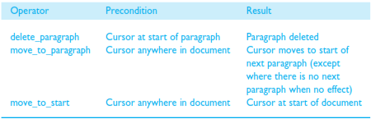
Answer ( Allowed States)

Slide 32
Answer (Goal)
Goal: delete second paragraph in document
Looking at the operators an obvious one to resolve this goal is delete_paragraph which has the precondition ‘cursor at start of paragraph’. We therefore have a
new subgoal: move_to_paragraph. The precondition is ‘cursor anywhere in document’ (which we can meet) but we want the second paragraph so we must initially be in the ﬁrst.

Slide 33
Analogy in Problem Solving
General who wants to attack the castle
Multiple thin roads leading to castle from different directions
Sends groups of troops from multiple directions

Slide 34
Analogy in Problem Solving
Doctor has to treat a patient of cancer
High dose of radiation is required to destroy cancer cells
Healthier cell can also be destroyed
SOLUTION ???
Is it analogous to previous example?

Slide 35
Skill Acquisition
Examine skill acquisition within context of problem space theory
Initial State (Chess playing)
Goal State (beat opponent)
Novice users
Expert users
Expert remember chunks of information in (Board configuration)

